Slide 1




Intro to Pandas
Manipulating excel files
"Intro to Pandas" by Sheldon Korpet is licensed under CC BY 4.0

Slide 2
Creating a Repl
Repl:
“an online integrated development environment (IDE) that allows developers to create small projects and run their programs”
a. Go to https://replit.com/ and sign in
b. Click “+ Create Repl”
c. Change “Blank Repl” to ‘Python’
d. It will show underneath
e. Give your repl a name e.g. pandas_test
f. Click “+ Create Repl”

Slide 3






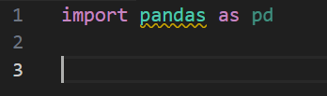
Python Libraries
What is a library?
Pre-written code and tools that extend the functionality of the Python programming language.
Importing a library (in replit)
At the start of your script:
Popular Python libraries:

Slide 4

Pandas
What is Pandas?
Intro video (1 min 30 secs)
https://www.linkedin.com/learning/python-for-data-visualization-2023/introduction-to-pandas
Pandas website (including docs)
https://pandas.pydata.org/
Pandas library
Created in 2008
By Wes Kinney (researcher)

Slide 5
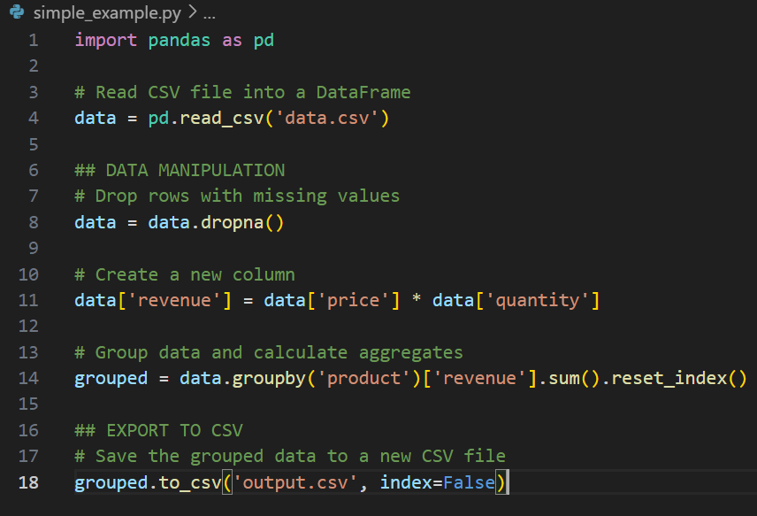
Pandas methods
Pandas example code:
What is a method?
Methods are like preprogrammed actions or behaviours.
Think of it like a real-world object, for example, a car, it has methods or actions that it can perform, like start, accelerate, and brake.
Which methods can I use?
head() – insert number of rows between the brackets to return the first rows of the dataframe
tail() – same as above but for end of df
describe() – returns info about the df
append – add more data to the df
merge – two dfs based on a common value
value_counts – counts how many of each value is present (like COUNTIF)

Slide 6
Useful Pandas Resources
Python for Data Analysis, 3E (free eBook) https://wesmckinney.com/book/
O'Reilly in general https://www.mmu.ac.uk/library/databases/oreilly-higher-education
• Pandas documentation for beginners - https://pandas.pydata.org/docs/getting_started/index.html#getting-started
• Documentation for anyone who uses Excel often https://pandas.pydata.org/docs/getting_started/comparison/comparison_with_spreadsheets.html#compare-with-spreadsheets
• Reading and writing data (tutorial) https://pandas.pydata.org/docs/getting_started/intro_tutorials/02_read_write.html
• Pandas practice exercises https://github.com/guipsamora/pandas_exercises

Slide 7
Python recap
From here, the slides cover Python basics…

Slide 8
Basic elements of Python
Computer program:
“a way of giving instructions to a computer about what it should do next.”
Comments
Variables
Functions
There are also:
Lists
Dictionaries

Slide 9
Basic elements
Comments
# comments are formatted like this
# comments explain what your code is doing
Variables
variable = ‘a value assigned to a keyword’
name = ‘sheldon’
user_number = 19
Functions
print(“This is how we format this function”)
print(42)
Lists
shopping_list = [‘apple’, ‘banana’, ‘cherry’ ]
lotto_numbers = [2,19,45,67,34,39]
Libraries
import random
There are lots and they can be found here https://pypi.org/
Naming Variables:
Don’t use use any of the Python keywords to name your variables! List here
Computer program:
“a way of giving instructions to a computer about what it should do next.”

Slide 10
Data Types
Data types:
used to define the type of a variable and what type of data can be stored in it
Numeric types – intergers, floating numbers, complex numbers
Sequence types – lists, tuples, ranges
Boolean types – True or False values
Mapping type - dictionaries
In Python, we call text (like what you’re reading now) strings or str
When you write strings in your program you surround them like this value assigned to a variable
name = ‘Sheldon’
OR name = “Sheldon”
Both of the above are exactly the same
In Python, numbers are called integers or int. They can just be typed e.g.
age = 32

Slide 11
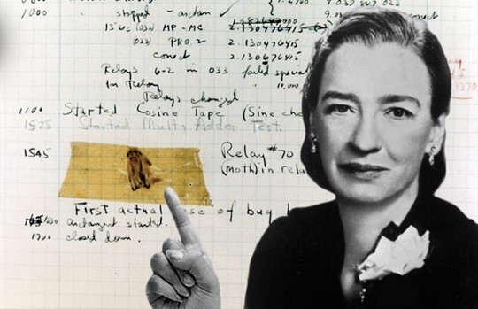
Debugging
When looking for problems in your code try:
Looking for typos e.g. prnt()
Checking your syntax e.g. print)
Look for logical errors e.g. your program can’t use a variable before you specify it
What is debugging?
Finding errors in your code.
Fun fact:
The term "debugging" originated in 1947 when Grace Hopper, a computer scientist and U.S. Navy Rear Admiral, found a moth that had gotten stuck in one of the computer's relays.

Slide 12
Debugging (expanded)
There are 3 types of common errors which can occur in Python:
1. Syntax errors – Python expects symbols (aka punctuation), to follow a protocol, indentation matters and keywords need to be spelt correctly
2. Runtime errors – a program encounters a condition it did not expect when trying to run e.g. trying to read data from a file which it can’t local or doesn’t exist.
3. Logical errors – there were no syntax or runtime errors but the output is not what was expected e.g. wrong function was used.
How do I read errors?
From the bottom – last line, up.

